Slide 1
Programming 4
02.1 File Structure
Semester 2, 2019

Slide 2
.h and .cpp
In C++, we need to separate the definition
of our classes from the implementation of
our classes.
Definitions go in .h
Implementations go in .cpp
For each class, we have a .h and .cpp file

Slide 3
C++ class definition syntax
Variables are declared but not initialised
Function prototypes are declared but no
implementation code
Visual C++ classes either have ref or value
A value class is one with no methods
There are three scoping options – private,
protected and public

Slide 4
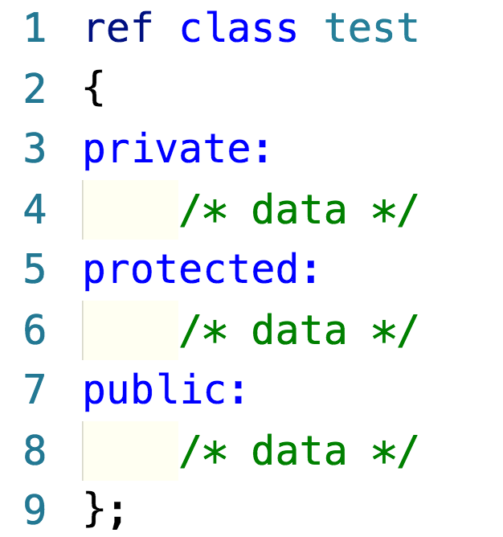
Example

Slide 5
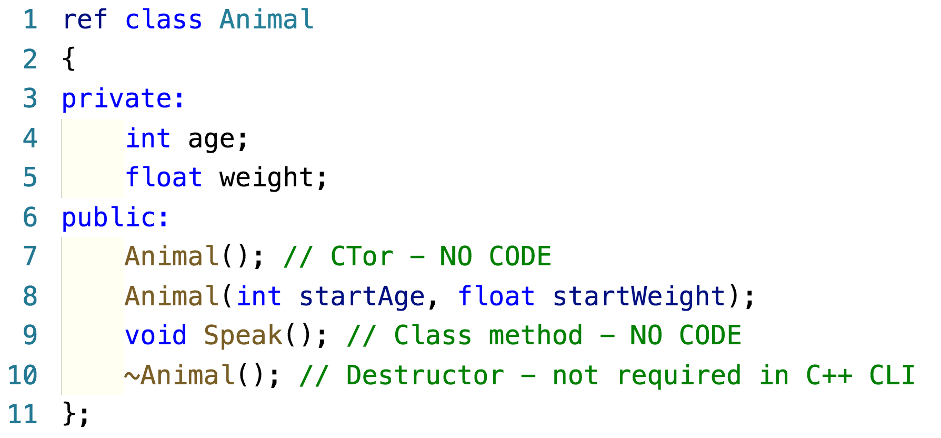
Example – Animal.h

Slide 6
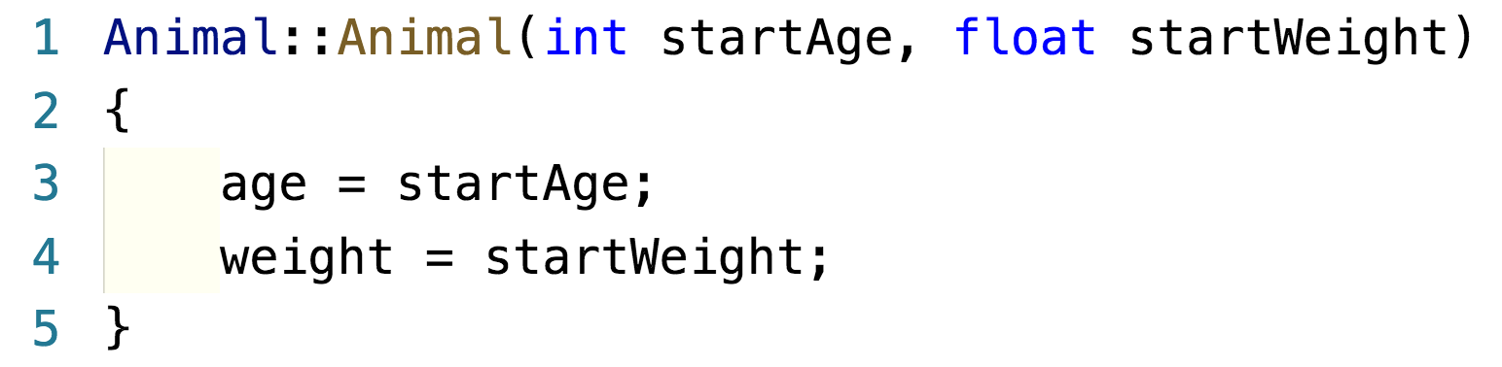
Example – Animal.cpp

Slide 7
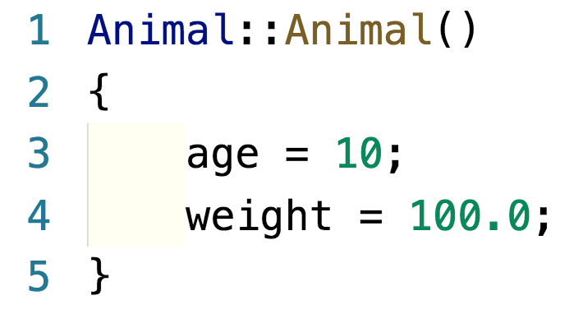
Example – Animal.cpp

Slide 8
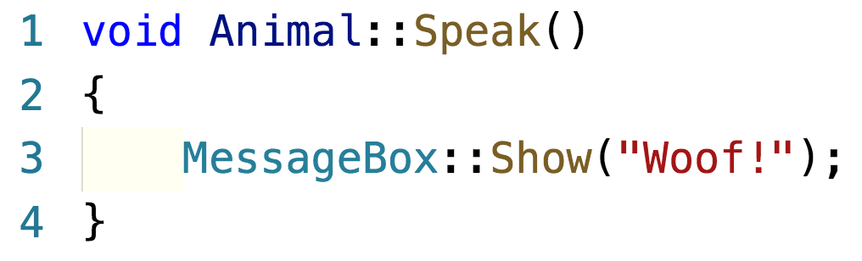
Example – Animal.cpp

Slide 9
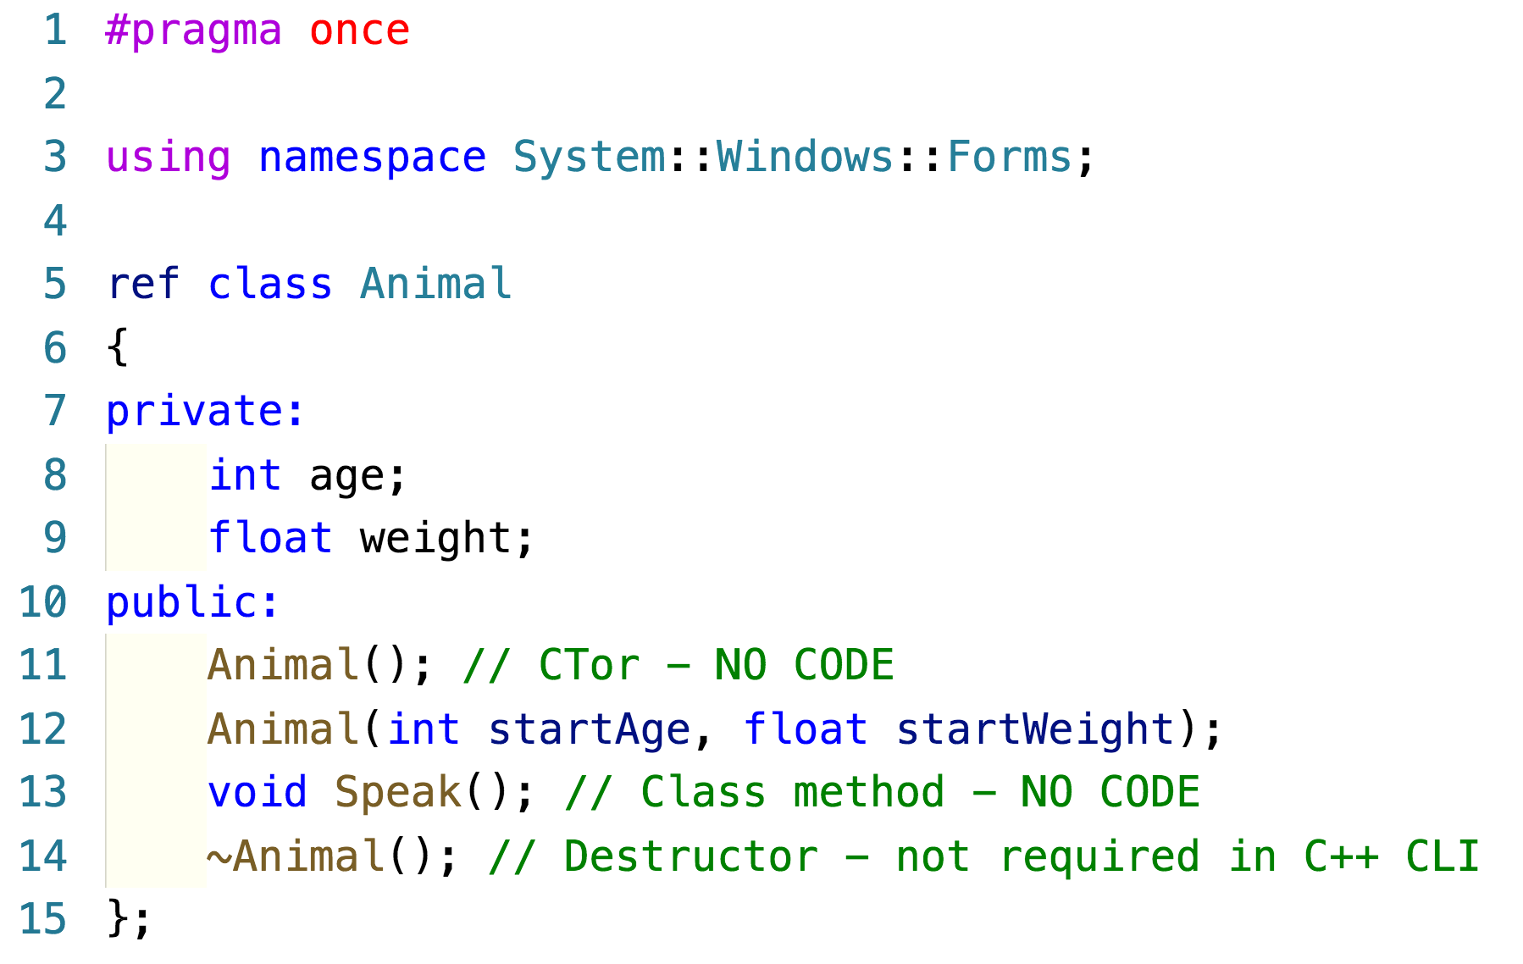
Example – Animal.h

Slide 10
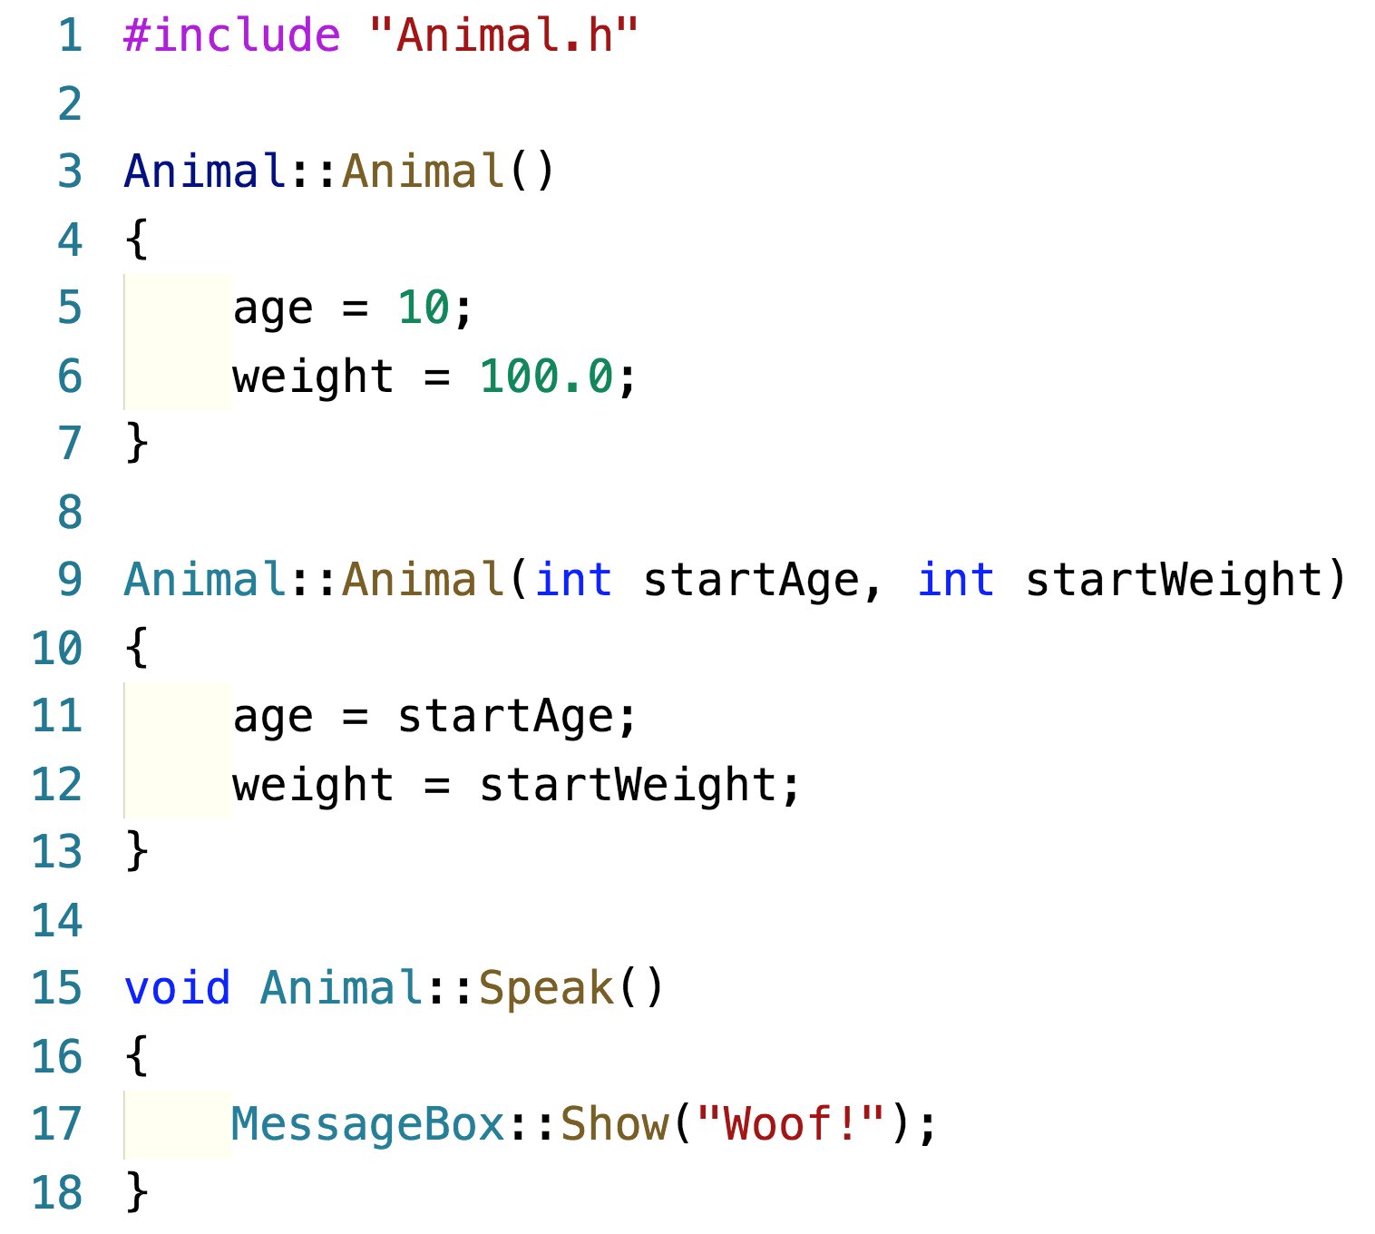
Example – Animal.cpp

Slide 11
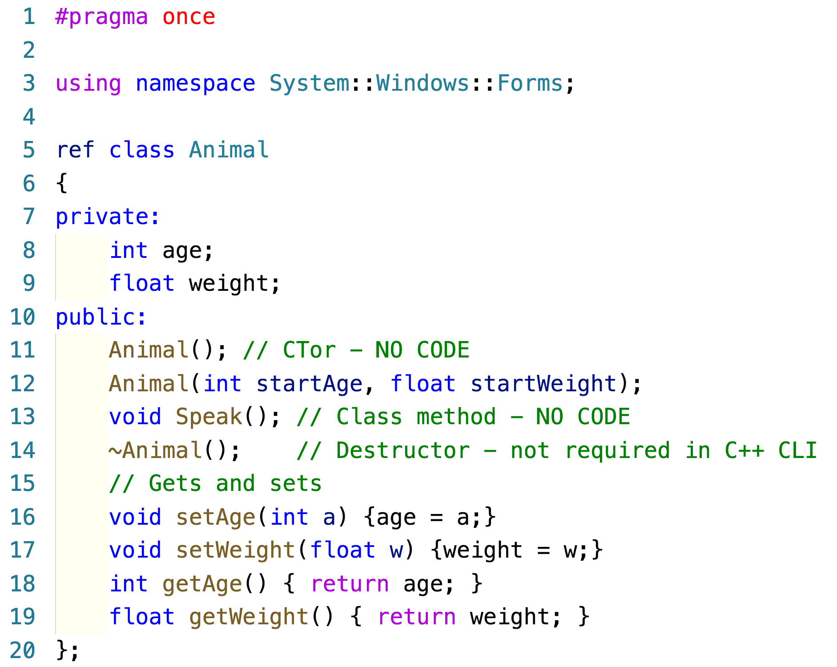
Implementing one line methods

Slide 12
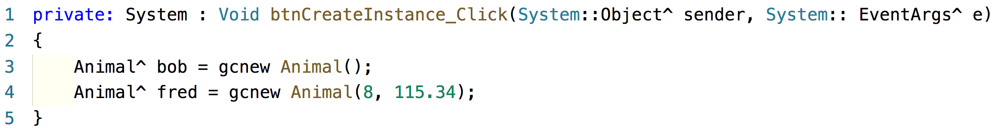
Create class instances

Slide 13
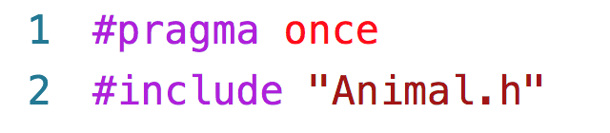
Remember #include

Slide 14
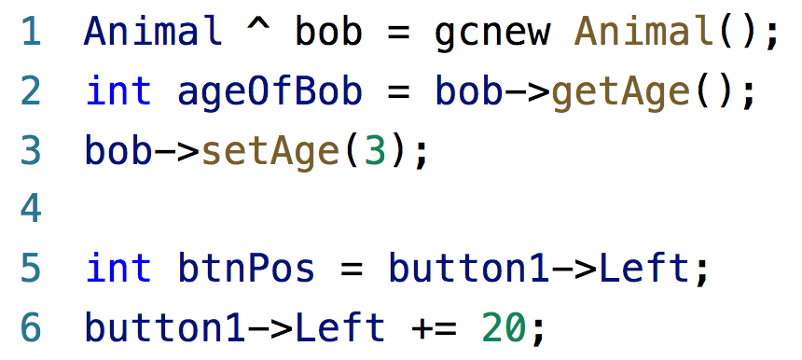
A .NET alternative to sets and gets
If class data members are private, and you
write set and get methods

Slide 15
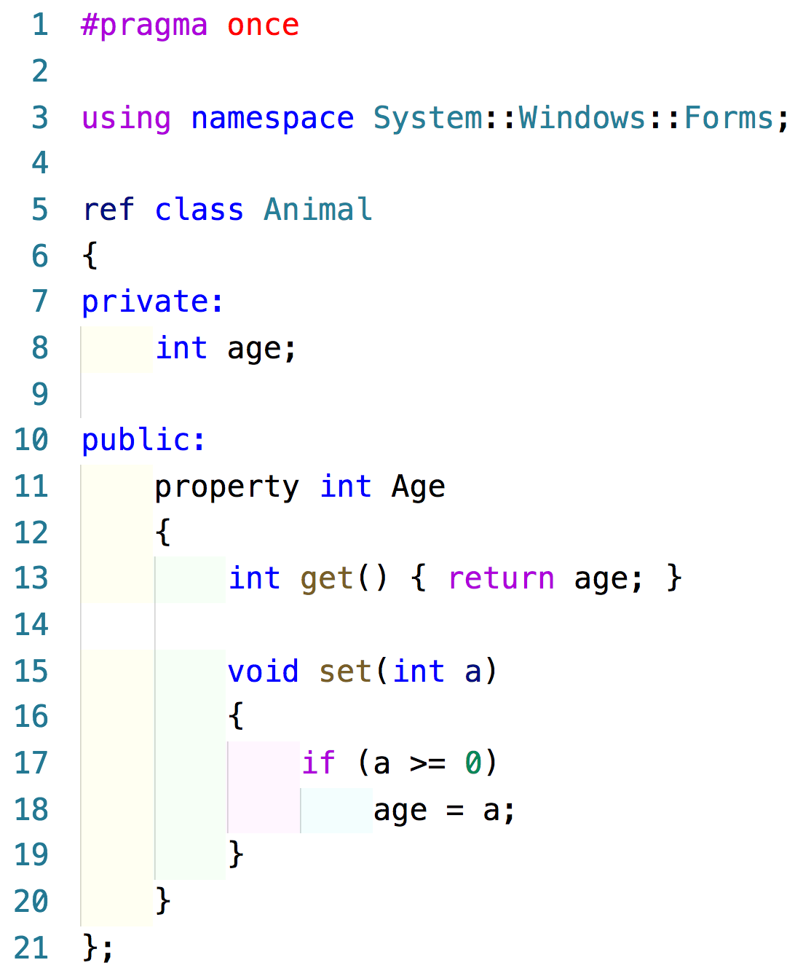
.NET property

Slide 16
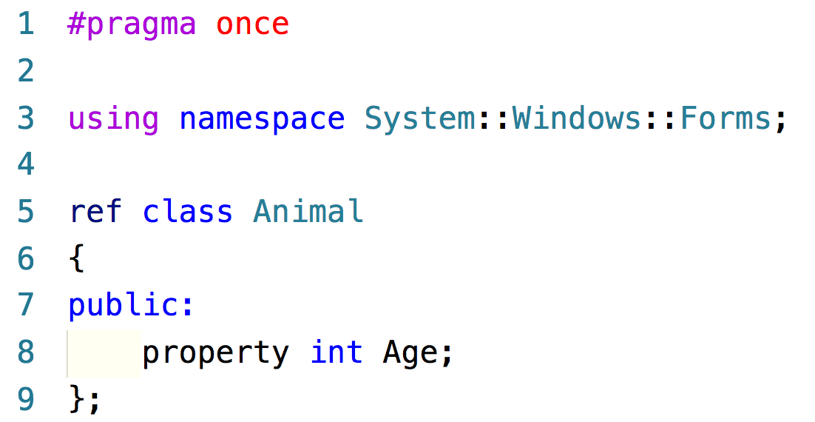
.NET property – less typing

Slide 17
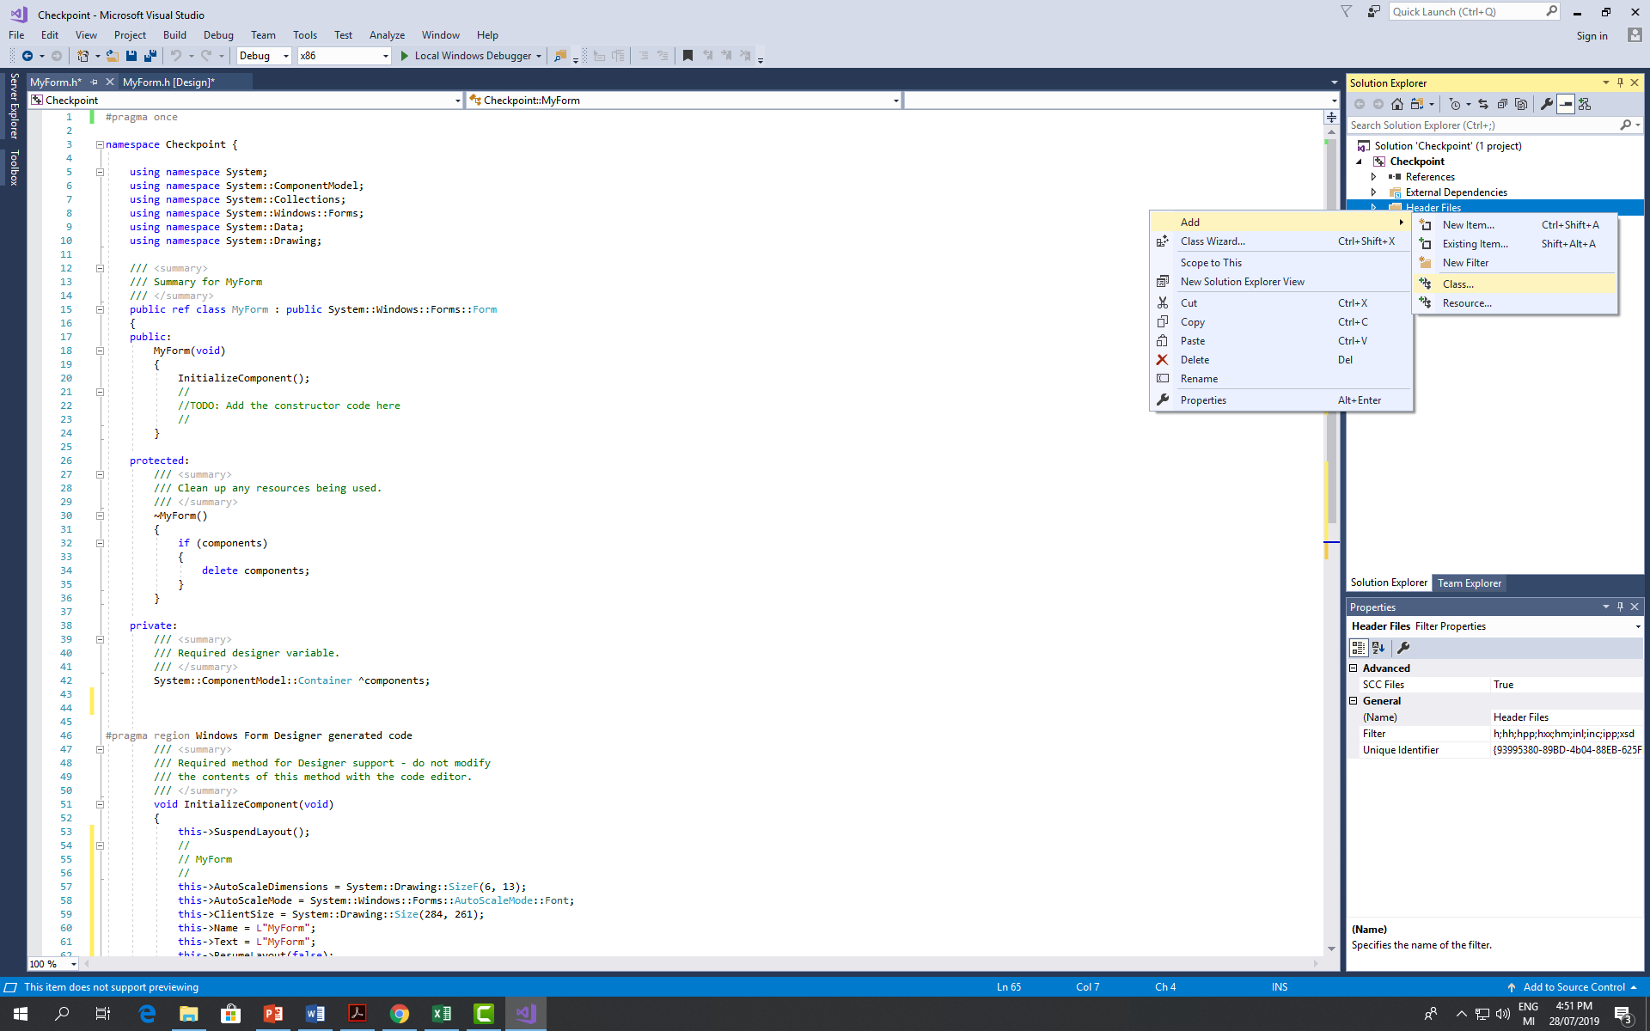
Creating a new class

Slide 18
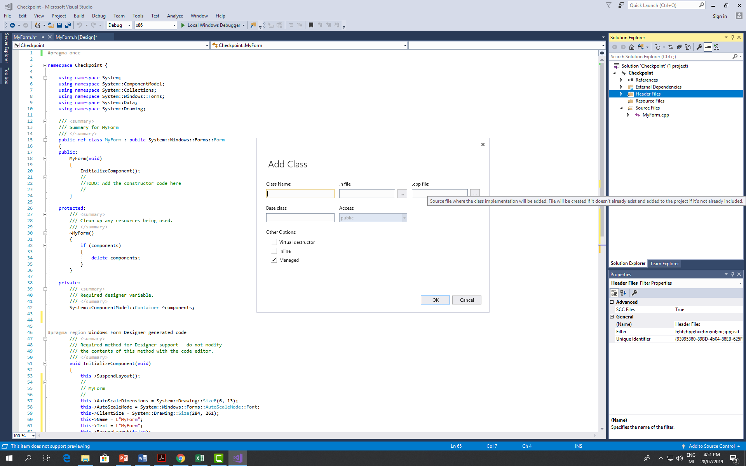
Creating a new class

Slide 19

Creating a new class

Slide 20
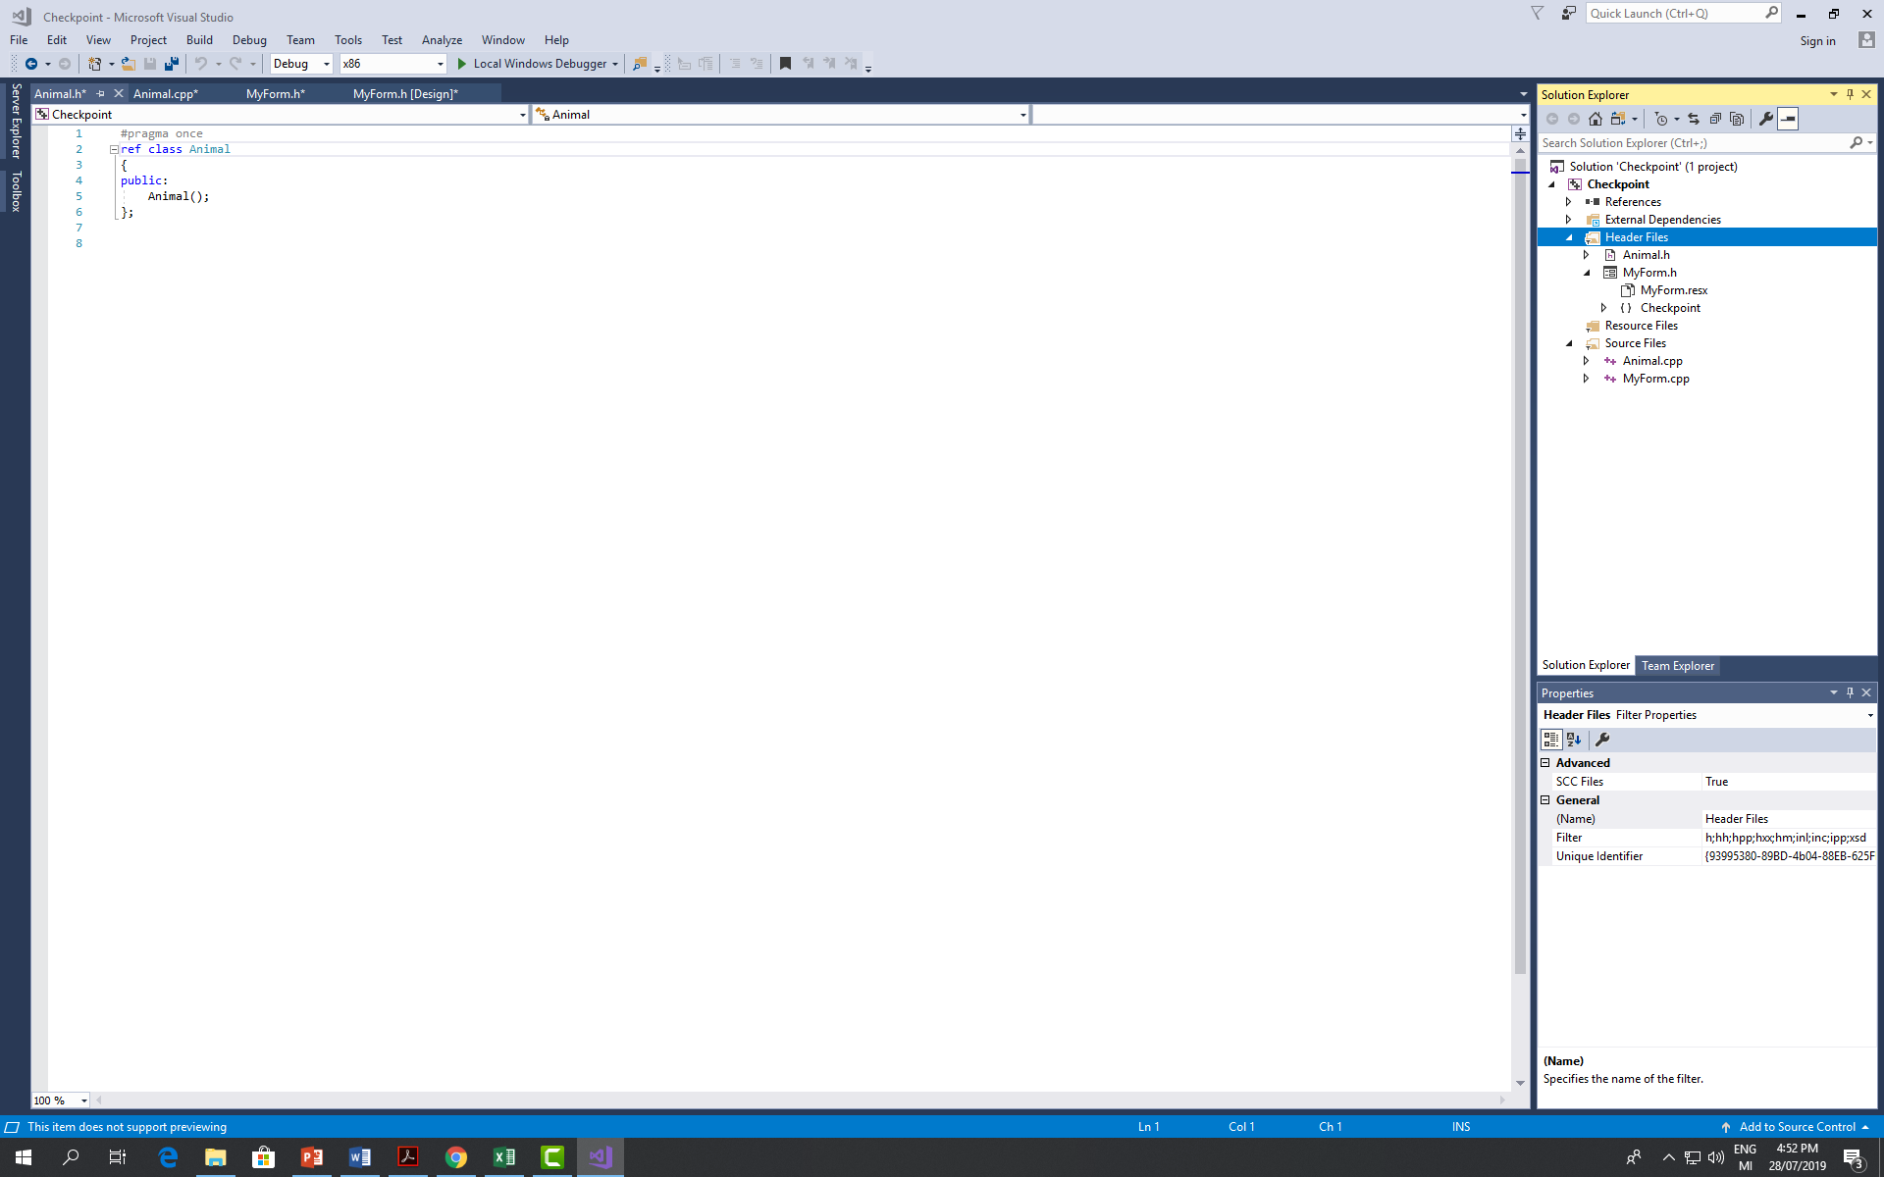
Creating a new class

